Slide 1
50th Year Celebration of Essex Economics Department 2015
Inequality – What can be Done?
A B Atkinson
“We are suffering just now from a bad attack of economic pessimism” – J M Keynes, 1930

Slide 2
Plan of talk
Essex in the 1970s
The extent of inequality
The economics of inequality
Proposals: Taxation and welfare state
Proposals: Employment and wages
Proposals: Capital and wealth
Assessment: what can be done?

Slide 3
Plan of talk
Essex in the 1970s
The extent of inequality
The economics of inequality
Proposals: Taxation and welfare state
Proposals: Employment and wages
Proposals: Capital and wealth
Assessment: what can be done?

Slide 4
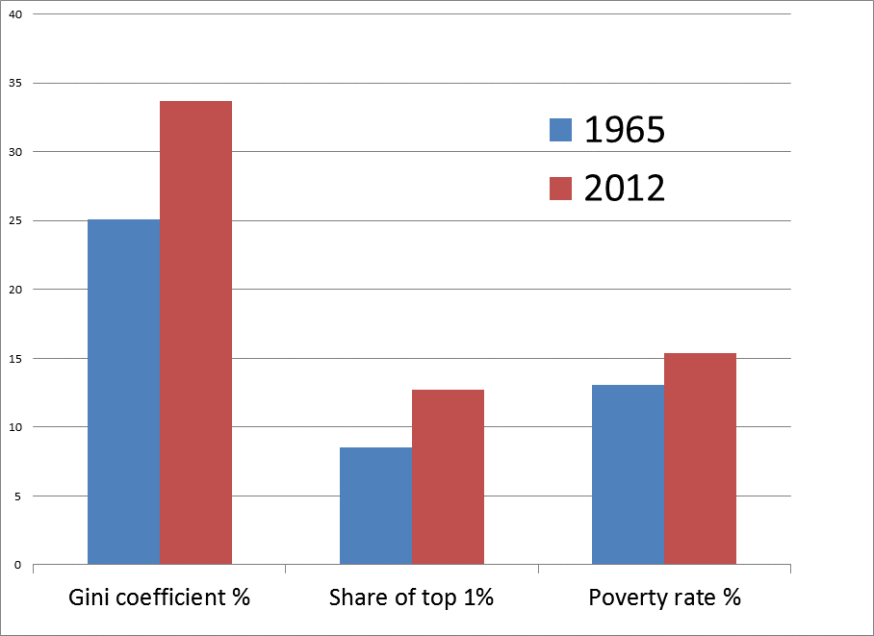
Inequality in UK 1965-2012

Slide 5
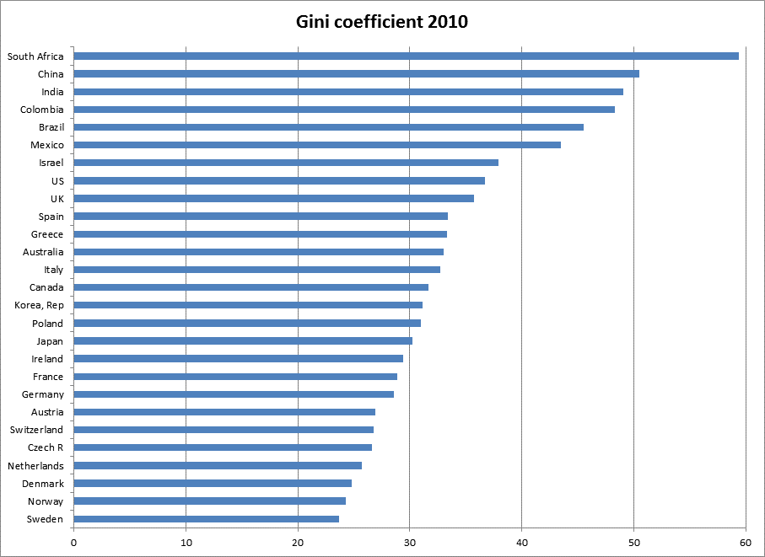
Income inequality compared

Slide 6
Plan of talk
Essex in the 1970s
The extent of inequality
The economics of inequality
Proposals: Taxation and welfare state
Proposals: Employment and wages
Proposals: Capital and wealth
Assessment: what can be done?

Slide 7
Many forces in operation
{
Earnings of Person 1
+ Earnings of Person 2
+ Income from Capital
+ Private transfers
+ State transfers
- Direct taxes
=
Disposable income
/
Number of equivalent adults
=
Household equivalent disposable income
2. Jobs and pay
{
3. Ownership and transmission of wealth
{
1. Welfare state and taxation

Slide 8
Plan of talk
Essex in the 1970s
The extent of inequality
The economics of inequality
Proposals: Taxation and welfare state
Proposals: Employment and wages
Proposals: Capital and wealth
Assessment: what can be done?

Slide 9
Proposals: Taxing more
Return to a more progressive rate structure for the income tax, with increasing marginal rates of tax up to a top rate of 65 per cent, accompanied by a broadening of the tax base.
Introduce into the personal income tax an Earned Income Discount, limited to the first tranche of earnings.
Change Inheritance Tax from a tax on giving to a tax on receiving, with a progressive lifetime capital receipts tax.
Council Tax to be replaced by a proportional property tax based on up-to-date property assessments.

Slide 10
Proposals: Spending more
A substantial child benefit should be paid for all children, and taxed as income.
A participation (citizen’s) income should be introduced, complementing existing social protection, with the prospect of an EU-wide child basic income.
OR Restore social insurance to reduce dependence on means-tested benefits.
Rich countries should raise their target for Official Development Assistance to 1 per cent of Gross National Income.

Slide 11
Plan of talk
Essex in the 1970s
The extent of inequality
The economics of inequality
Proposals: Taxation and welfare state
Proposals: Employment and wages
Proposals: Capital and wealth
Assessment: what can be done?

Slide 12
Proposals: employment and wages
Governments should adopt an explicit target for reducing unemployment (as there is a target for inflation), and offer guaranteed public employment.
There should be a national pay policy: with the minimum wage set at the Living Wage, and a code of practice for pay above the minimum.
The direction of technological change should be an explicit concern of policy-makers, encouraging innovation in a form that increases the employability of workers, emphasising the human dimension of service provision.

Slide 13
Plan of talk
Essex in the 1970s
The extent of inequality
The economics of inequality
Proposals: Taxation and welfare state
Proposals: Employment and wages
Proposals: Capital and wealth
Assessment: what can be done?

Slide 14
Proposals: Capital and wealth
(a) Introduce a distributional dimension into competition policy, (b) ensure a legal framework that allows trade unions to represent workers on level terms, and (c) establish a new Social and Economic Council with wide representation.
The government should offer via national savings bonds a guaranteed positive real rate of interest on savings, with a maximum holding per person.
There should be a capital endowment (minimum inheritance) paid to all at adulthood.
Creation of a public Investment Authority, operating a sovereign wealth fund to build up the state net worth.

Slide 15
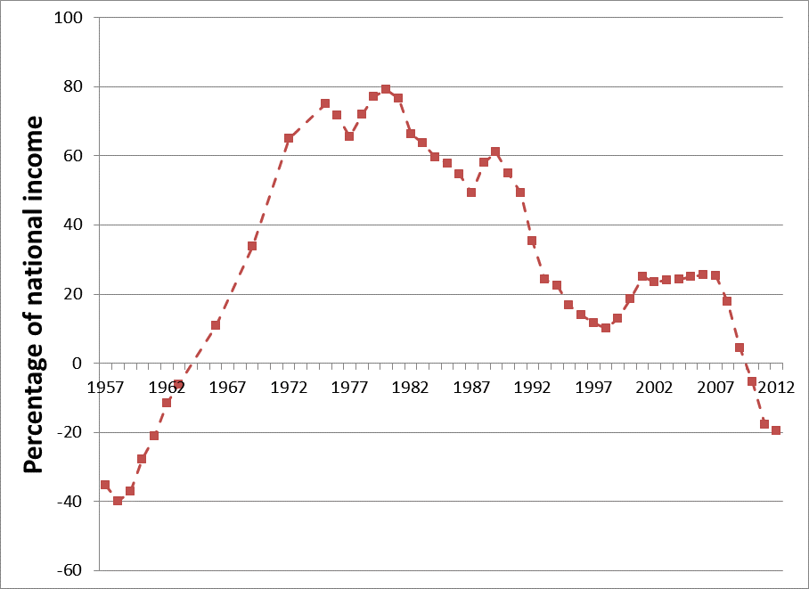
Decline in net worth of the state as % national income

Slide 16
Plan of talk
Essex in the 1970s
The extent of inequality
The economics of inequality
Proposals: Taxation and welfare state
Proposals: Employment and wages
Proposals: Capital and wealth
Assessment: what can be done?

Slide 17
Are these proposals “off-the-wall”?
SUPPORTERS:
Competition policy and distribution: US Senator Sherman
Social and Economic Council: 22 EU countries
Public Employment Programme: US Humphrey-Hawkins Act 1978
Living wage: UK Premier League Football Clubs
Lifetime capital receipts tax: J S Mill and Lord Randolph Churchill
Minimum inheritance: Thomas Paine and previous UK Labour Government
Sovereign wealth fund: Boris Johnson, Conservative Mayor of London
Property tax: Most US local governments
Participation (Citizen’s) Income: James Meade and Green Party

Slide 18
Are these proposals debatable? YES!
Objection: “The equity/efficiency trade-off means that national income/growth will be reduced”.
Response: standard economic models tend to exclude the ways in which equity and efficiency can be complementary, and ignore the safeguards introduced in the institutional design of redistributive policies.
Objection: “In a globalized economy, one country cannot pursue such a path”.
Response: countries are not simply passive agents in the face of world developments.
Objection: “We cannot afford it”.
Response: Costed programmes for the UK where the tax
and transfer elements would reduce the Gini coefficient and the rate of poverty by 4 percentage points.

